Slide 1




NEXT GEN EMPLOYABILITY PROGRAM
Creating a future-ready workforce
Team Members
College Name
Student Name : Malarvizhi R
Student ID : au711021205013
Info Institute of Engineering

Slide 2

CAPSTONE PROJECT SHOWCASE
Project Title
Notes Sharing Web Application using Django Framework
Abstract | Problem Statement | Project Overview | Proposed Solution | Technology Used | Modelling & Results | Conclusion

Slide 3
Abstract
Students can share and access their study materials and course notes via NoteBlend, an online platform. Teachers can post their notes to the website, which offers a central repository arranged by university, course, and class part. Students are able to explore and download notes on any subject they like. Easy-to-use features like a dashboard and download choices make it simple for users to access the notes in the notes sharing system. This website provides a number of functions, such as the ability to view, download, and upload notes that are accessible to other users.
Source :
GitHub

Slide 4
Problem Statement
Particularly in fast-paced or complex courses, students frequently struggle to take thorough notes during lectures, which can result in knowledge gaps and possible academic underperformance.
Furthermore, various students can have unique viewpoints or insights that would be helpful to their peers.
The purpose of this project is to create a notes-sharing platform that allows students to easily share study materials and course notes, thereby addressing these problems.
Source :
GitHub

Slide 5
Project Overview
Notes Sharing Website is a platform designed for seamless sharing of study materials. It makes it easier for teachers and students to collaborate by offering a user-friendly interface for posting, organizing, and retrieving notes and documents. Any student can utilize the user-friendly website, which increases productivity. There are many benefits to this project, chief among them being how simple it is to keep notes and manage project levels. We don't have to keep track of everything by hand when we may arrange notes according to subject. It has a great deal of future potential. It could be readily updated as needed and utilized inside particular businesses.
Source :
GitHub

Slide 6
Proposed Solution
.
The objective of implementing an Online Notes Sharing platform is to facilitate seamless digital sharing of notes and documents among students and teachers.
Digital note sharing: Teachers have the ability to safely upload, save, and distribute their documents and notes via the internet. This makes it unnecessary to submit materials in person and provides easy access to study resources from any location with an internet connection.
Access Control: Administrators have the ability to specify permissions and access levels for various user roles, such as administrators, teachers, and students. Access control improves system security and privacy by limiting who may read, change, and remove particular documents to those who are permitted.
Source :
GitHub

Slide 7
Responsive Design: Using a responsive design to make sure the platform works and is available across a range of devices, such as tablets, smartphones, laptops, and desktop computers.
Scalability: Build the system with the ability to handle increasing volumes of users and documents without compromising on usability or speed.
Source :
GitHub

Slide 8
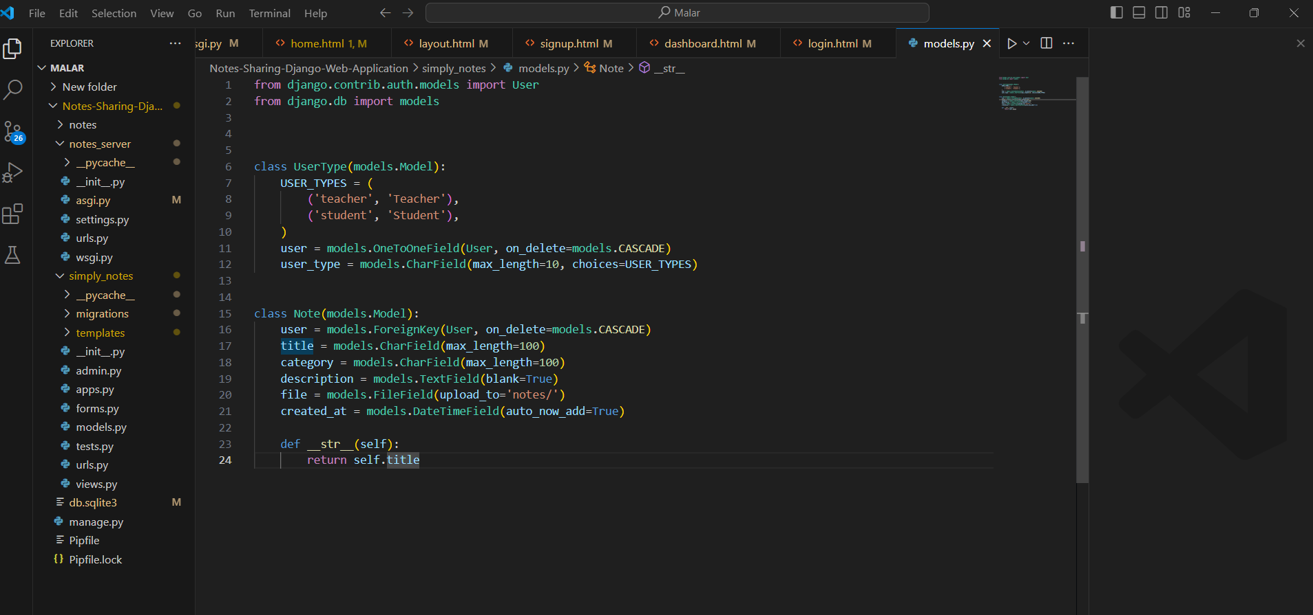
Source :
GitHub

Slide 9


Technology Used
Front-end
Back-end
Source :
GitHub

Slide 10
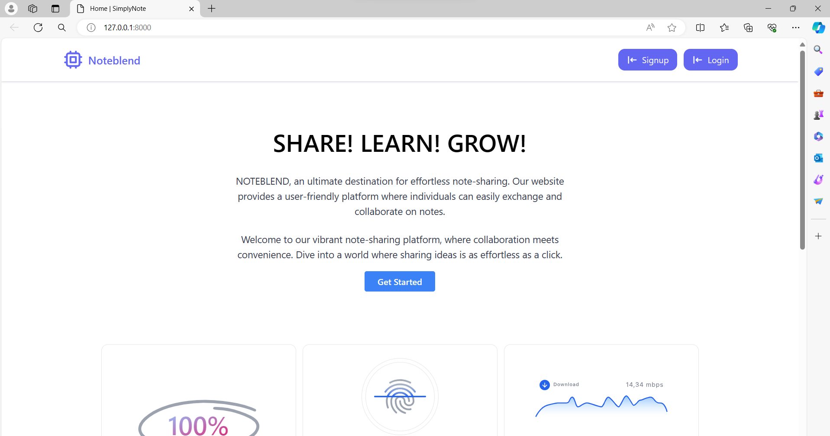
Modelling & Results

Slide 11
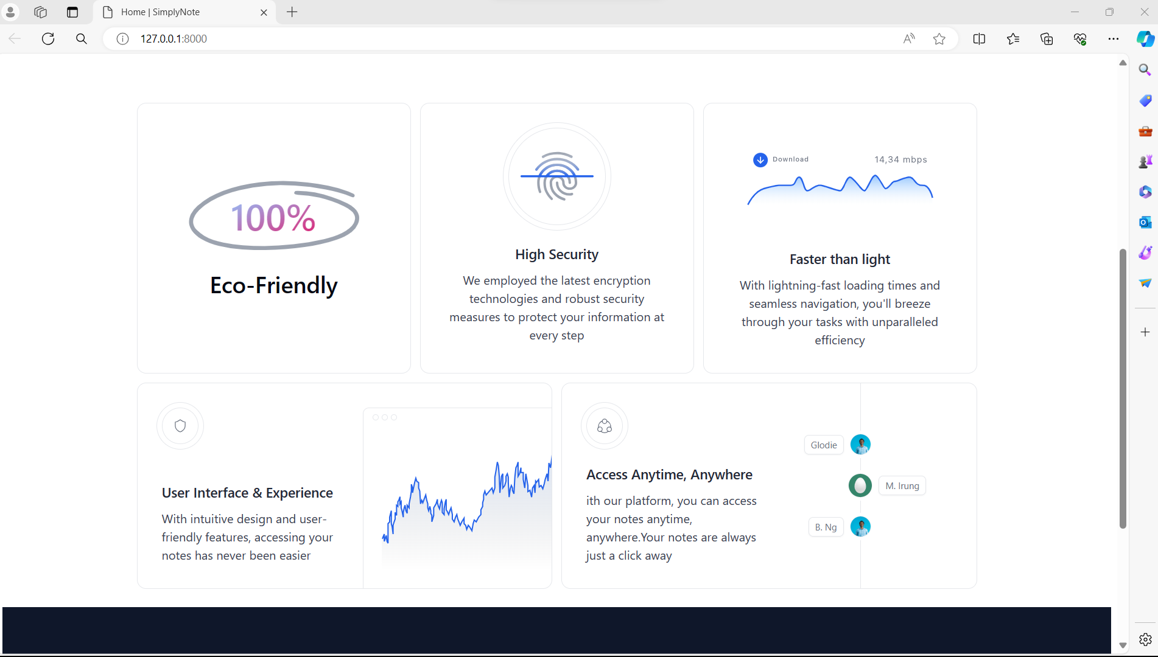
Home Page
Source :
GitHub

Slide 12
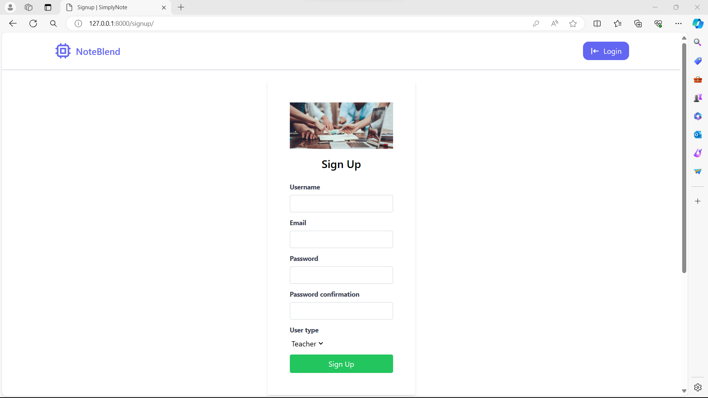
Sign up Page

Slide 13
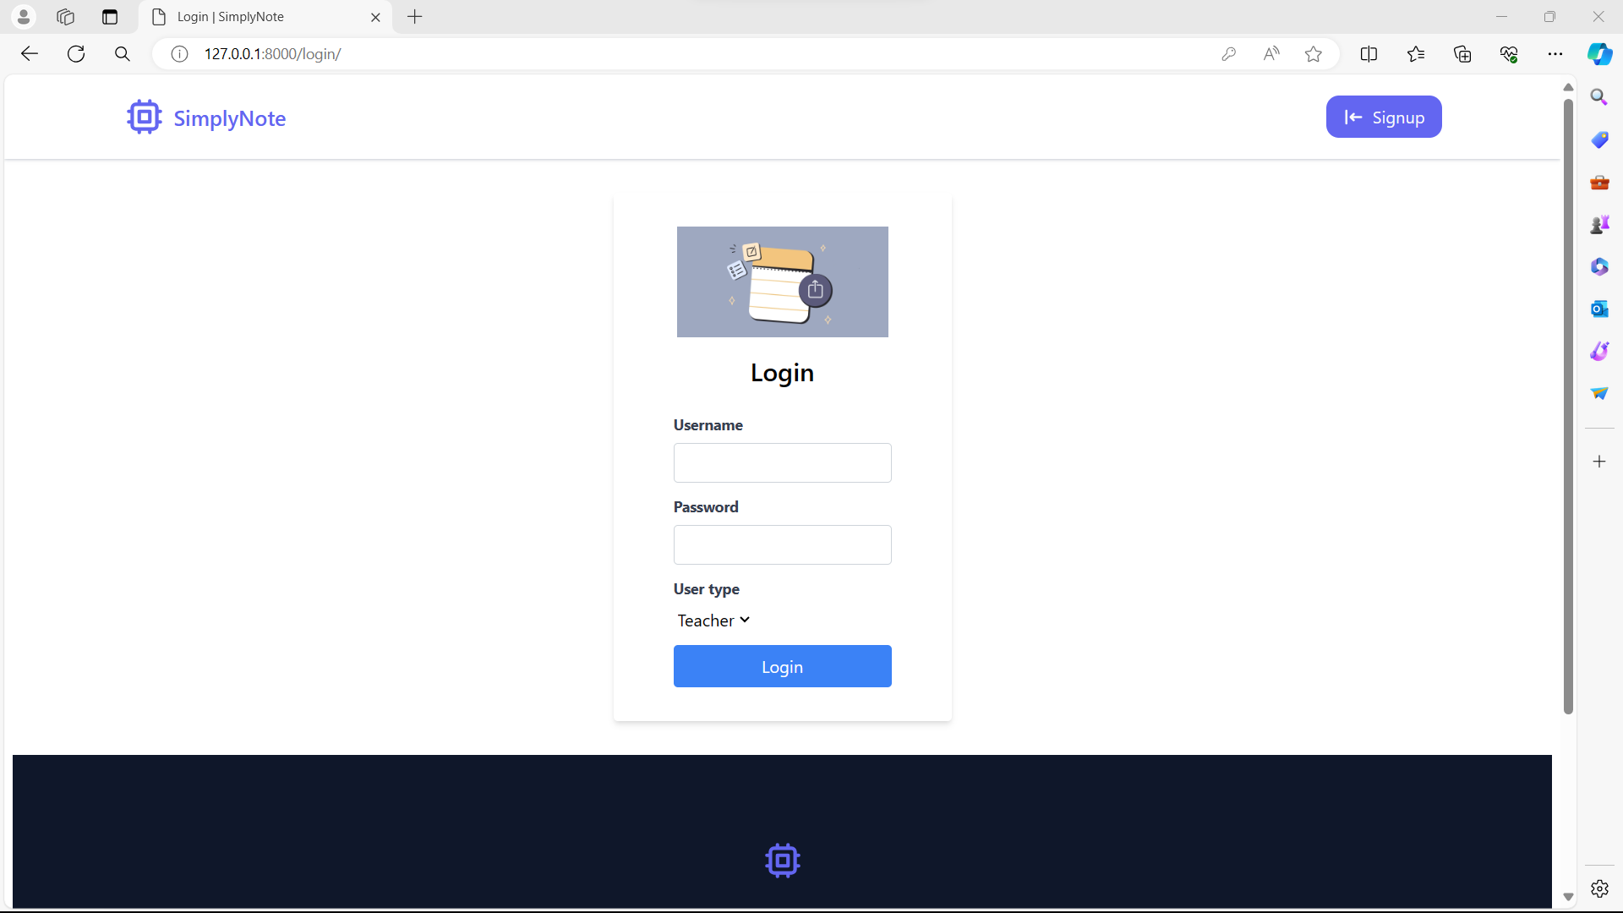
Login Page

Slide 14

Footer Page

Slide 15
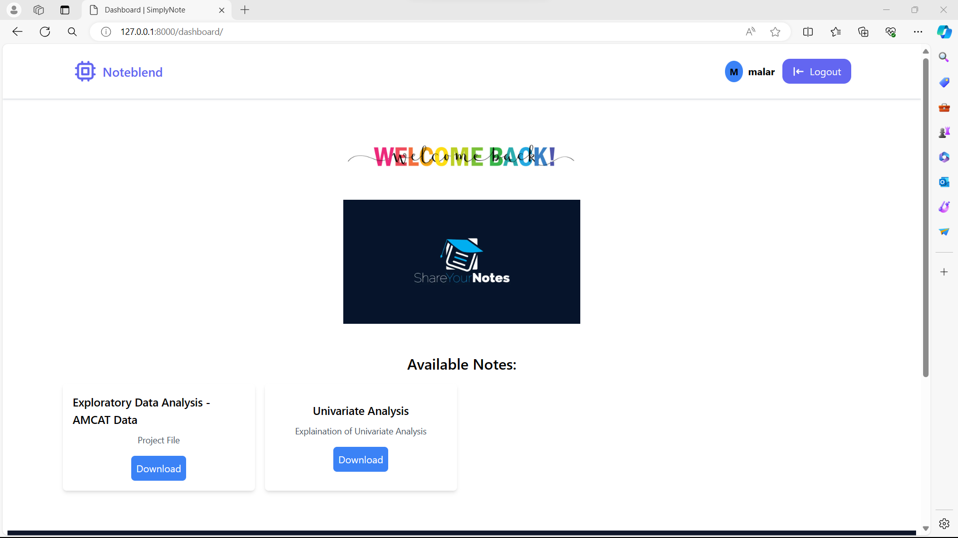
Dashboard Page

Slide 16
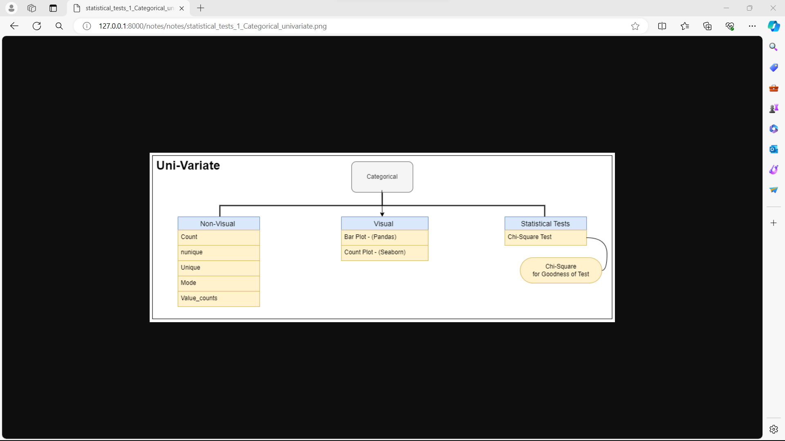
Viewing Notes

Slide 17
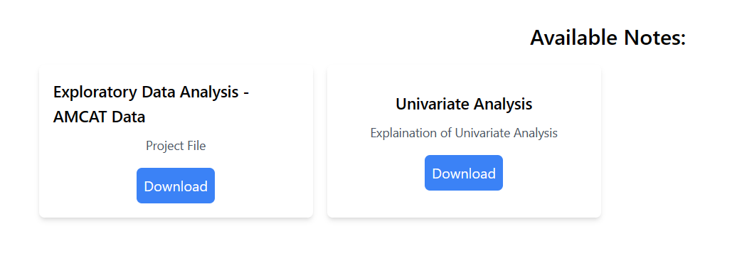
Available Notes

Slide 18
Future Enhancements:
A number of features to boost efficiency and productivity could be added to the notes sharing project website in the future:
Eco-beneficial Note-Taking: Creating features that are beneficial to the environment, including digital notebooks that resemble traditional paper.
Improved Collaboration Features: Enabling real-time editing, shared notebooks, and the capacity to leave comments on particular notes will all help users collaborate effectively, which would be especially helpful for students.
Integration with AI Tools: Organizing and searching notes more effectively could make it easier for users to locate information fast when needed. Examples of these AI tools include natural language processing algorithms.

Slide 19
Conclusion
To sum up, the notes sharing project is a useful tool for instructors and students to work together and share notes online. Due to the open-source nature of the project, users can alter and customize it to suit their unique requirements. All things considered, the notes sharing project is a useful instrument for encouraging cooperation and knowledge exchange in a variety of settings. Through the project's digital note-sharing and note-access capabilities, efficiency, productivity, and learning outcomes can all be enhanced.
Source :
GitHub

Slide 20
Thank You!
Notes:
Thank You !!

